Slide 1
Learning Neural Differential Algebraic Equations via Operator Splitting
Ján Drgoňa
Associate Professor Civil and Systems Engineering Department Electrical and Computer Engineering Department (secondary) The Ralph O'Connor Sustainable Energy Institute (ROSEI)
Data Science and AI Institute (DSAI)

Slide 2
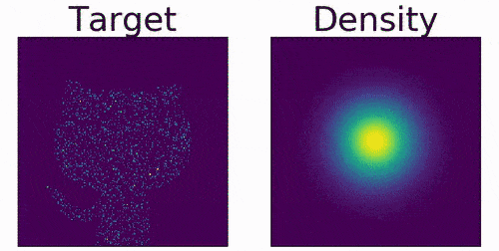
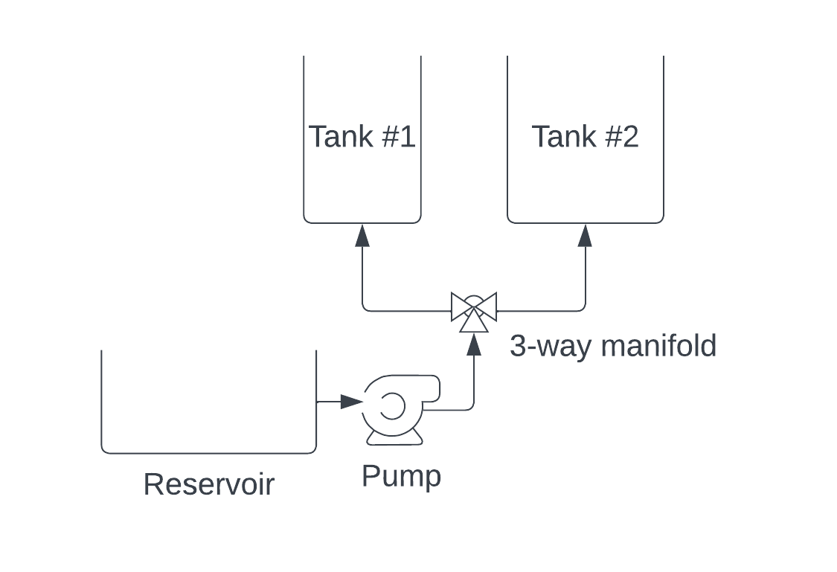
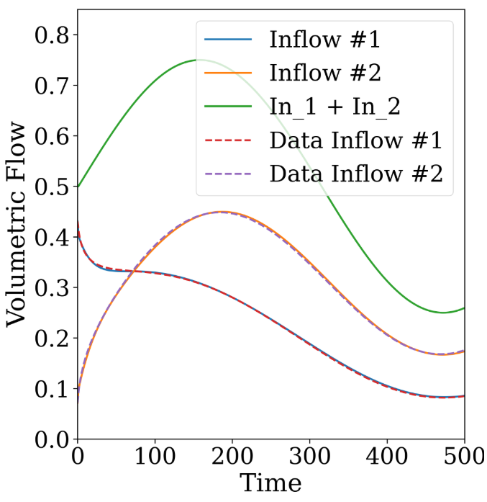
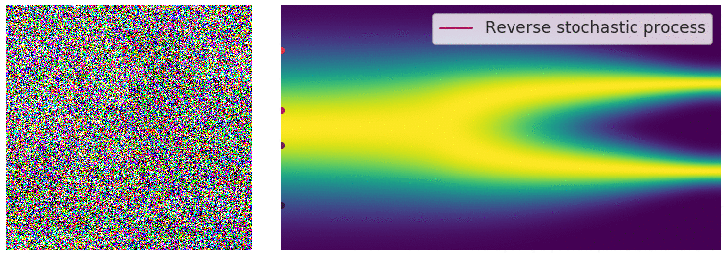
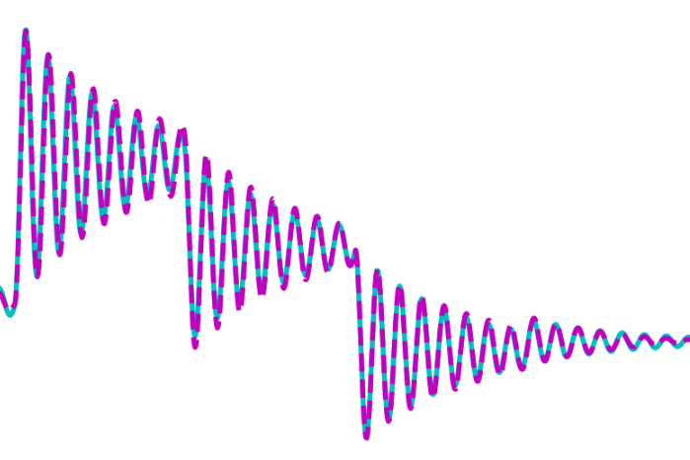
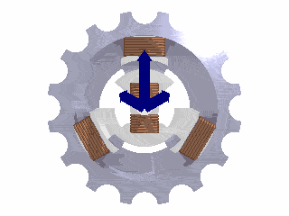
Applications of Neural Differential Equations (NDEs)
Generative AI: normalizing flows
Constrained nonlinear system identification
Will Grathwohl et al., "FFJORD: Free-form Continuous Dynamics for Scalable Reversible Generative Models." ICLR, 2019.
James Koch, et al., Learning Neural Differential Algebraic Equations via Operator Splitting, CDC, 2025
Generative AI: diffusion-based models
Power systems modeling
Yang Song, et al., Score-Based Generative Modeling through Stochastic Differential Equations, ICLR 2021. Image from https://yang-song.net/blog/2021/score/
X. Kong, et al., Dynamic Parameter Estimation with Physics-based Neural Ordinary Differential Equations, IEEE PESGM, 2022

Slide 3

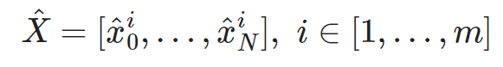
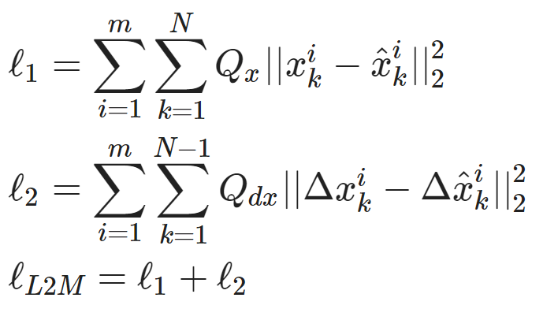
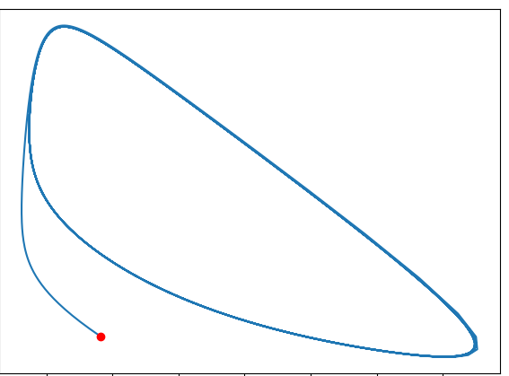
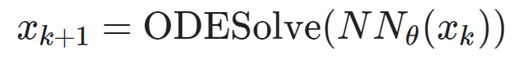
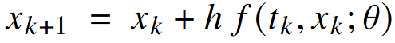
Neural Ordinary Differential Equations (NODEs) for System Identification
Dataset: time-series of states, inputs, and disturbances tuples.
Architecture: differentiable ODE solver with neural network model.
Loss function: trajectory matching, regularizations, and constraints penalties.
Explicit Euler ODE solver:
https://github.com/pnnl/neuromancer/blob/master/examples/ODEs/Part_1_NODE.ipynb
R. T. Q. Chen, et al., Neural Ordinary Differential Equations, 2019

Slide 4
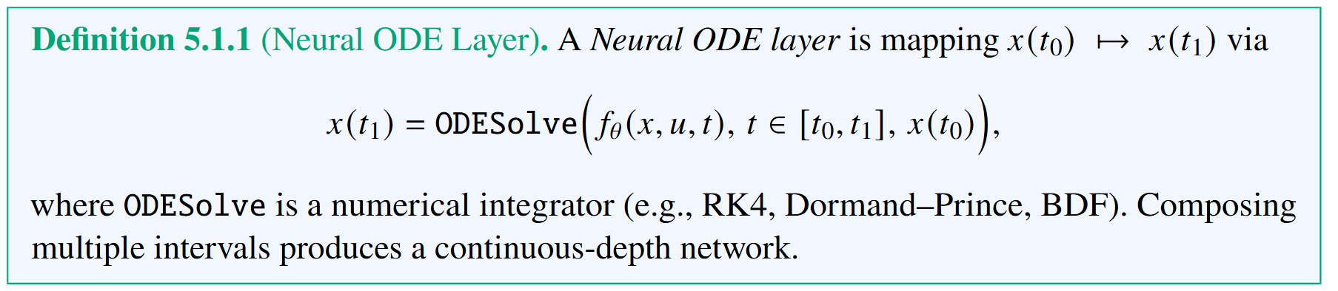
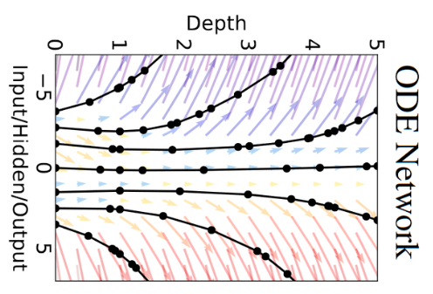
NODE Layers
R. T. Q. Chen, et al., Neural Ordinary Differential Equations, 2019

Slide 5
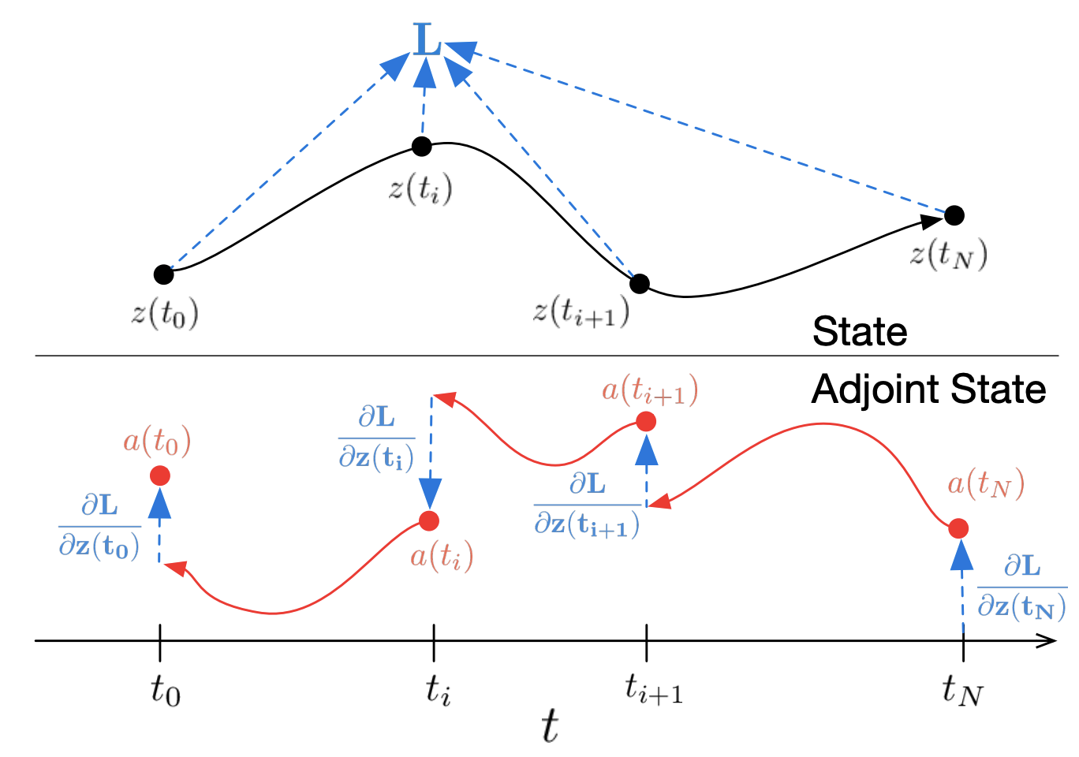
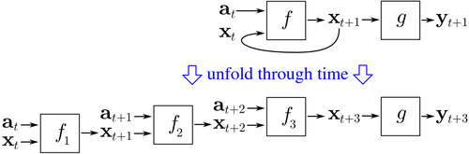
Differentiating Through the ODE Solver
Backpropagation through time (BPTT)
Adjoint sensitivity method
Pros: exact for discretized systems, numerically more stable, wide support in modern AD libraries
Cons: high memory cost, requires storing all intermediate variables
Pros: memory efficiency, no need to store intermediate variables, strong theory
Cons: error accumulation leading to numerical instability
https://en.wikipedia.org/wiki/Backpropagation_through_time
R. T. Q. Chen, et al., Neural Ordinary Differential Equations, 2019

Slide 6
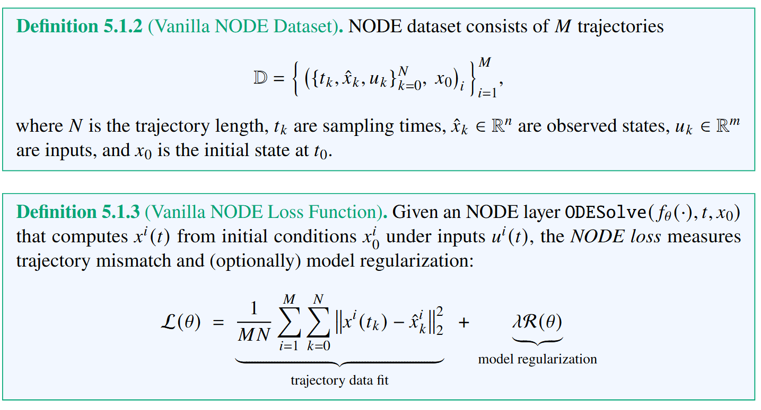
NODE Dataset and Loss Function

Slide 7
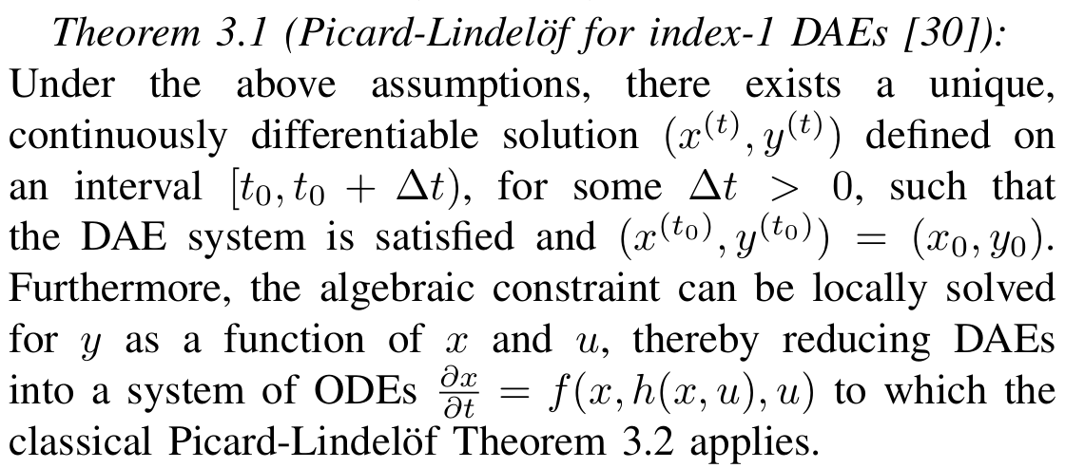
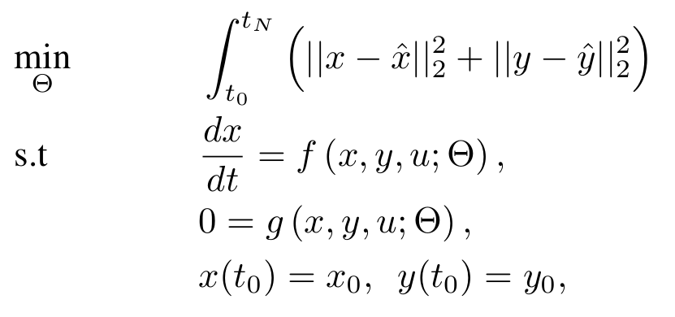
Neural Differential Algebraic Equations (NDAEs) Problem Formulation
DAE parameter estimation problem
Assumptions:
𝑓 is continuous in its arguments
𝑓 is Lipschitz continuous in 𝑥 on some neighborhood of initial conditions
The Picard–Lindelöf theorem (also called the Cauchy–Lipschitz theorem) gives sufficient conditions under which an initial value problem (IVP) for an ordinary differential equation (ODE) has a unique solution.
[30] K. E. Brenan, S. L. Campbell, and L. R. Petzold, Numerical Solution of Initial-Value Problems in Differential-Algebraic Equations. SIAM, 1996.

Slide 8
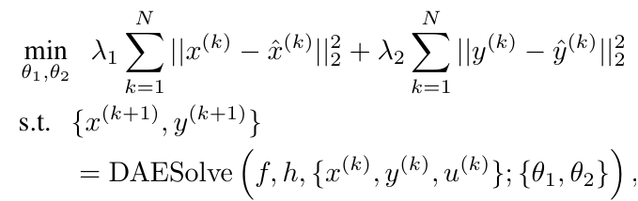
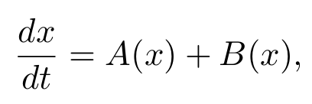
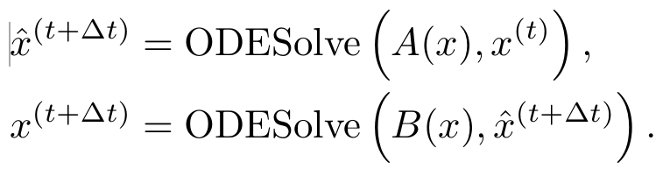
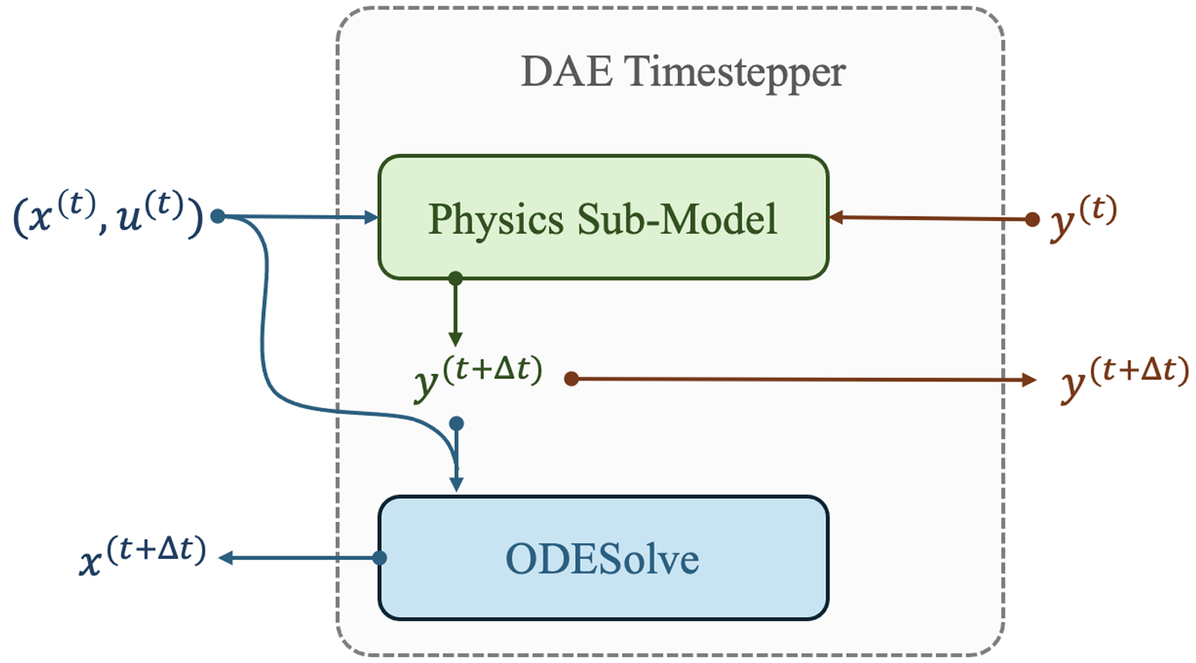
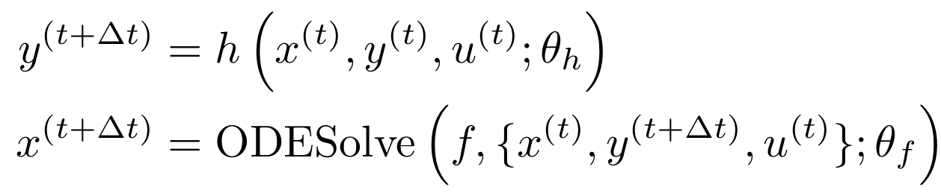
Learning Neural Differential Algebraic Equations via Operator Splitting
Our neural DAE time stepper architecture is inspired by operator splitting methods for ODEs:
Neural DAE learning problem:
Lie-Trotter splitting scheme for ODEs:
Operator splitting for DAEs:
Picard-Lindelof Theorem for index-1 DAEs.
J. Koch, M. Shapiro, H. Sharma, D. Vrabie, J. Drgona, Learning Neural Differential Algebraic Equations via Operator Splitting, arXiv:2403.12938, 2024.

Slide 9
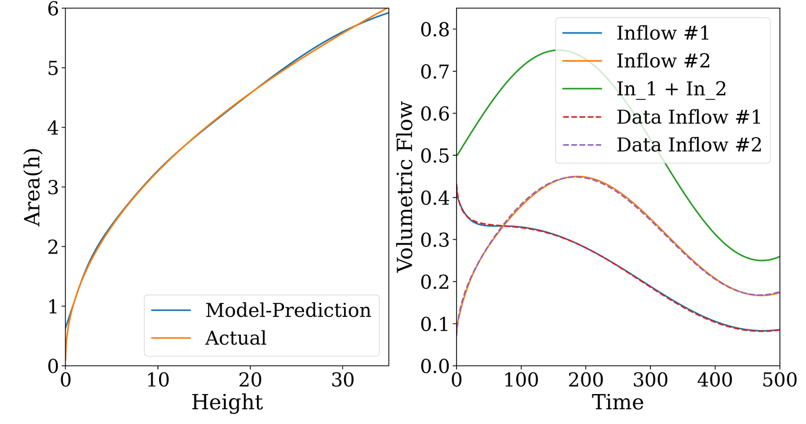
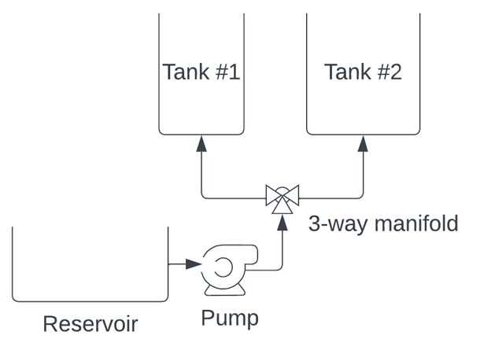
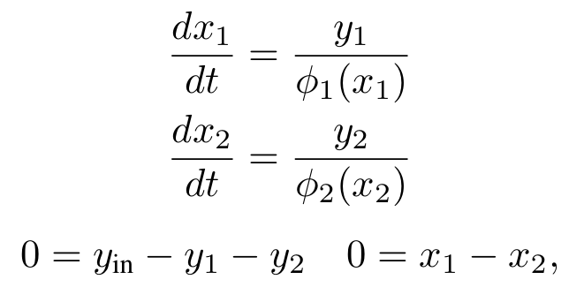
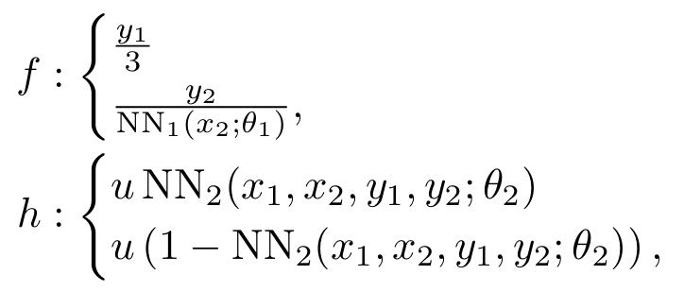
Tank-Manifold Pump Modeling Problem
Tank-manifold pump schematics
DAE with unknown components:
Neural DAE:
DAE inverse modeling, with satisfied conservation laws.
drgona.github.io/NeuralDAEs/
J. Koch, M. Shapiro, H. Sharma, D. Vrabie, J. Drgona, Learning Neural Differential Algebraic Equations via Operator Splitting, arXiv:2403.12938, 2024.

Slide 10
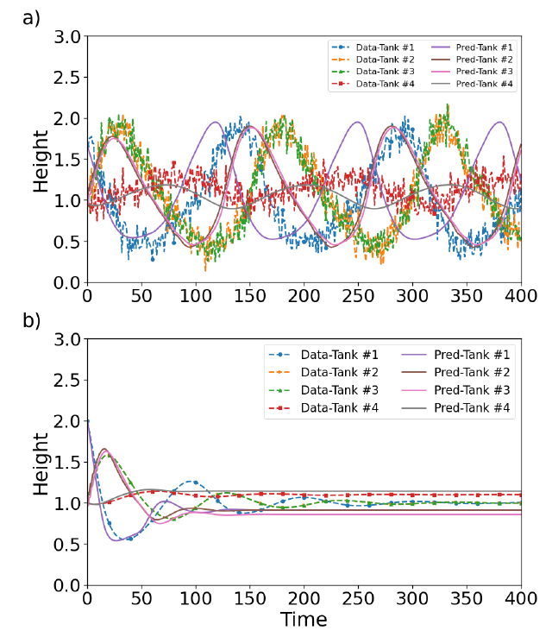
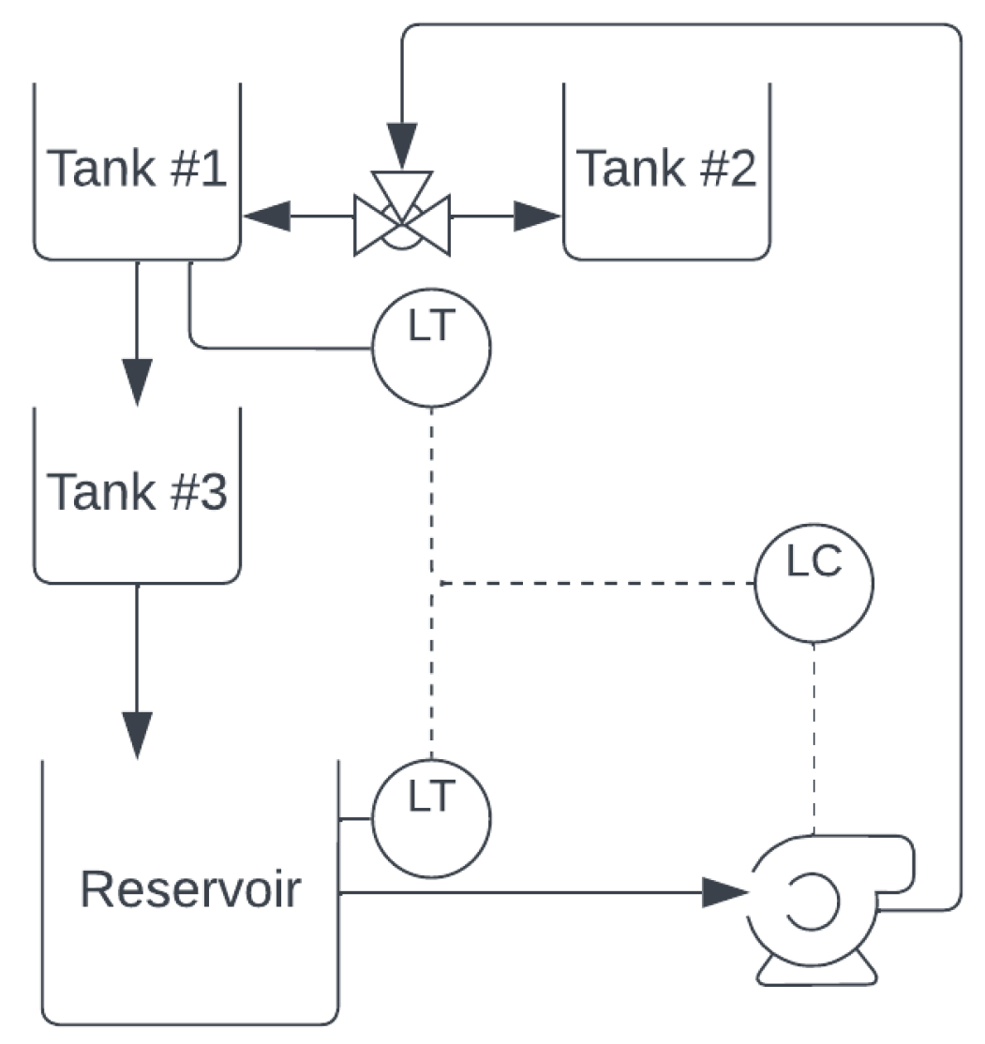
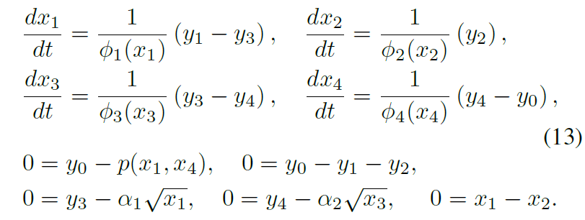
Tank Network Modeling Problem
Network system schematics
DAE with unknown components:
a) Noisy data vs prediction. b) Extrapolation.
J. Koch, M. Shapiro, H. Sharma, D. Vrabie, J. Drgona, Learning Neural Differential Algebraic Equations via Operator Splitting, arXiv:2403.12938, 2024.

Slide 11

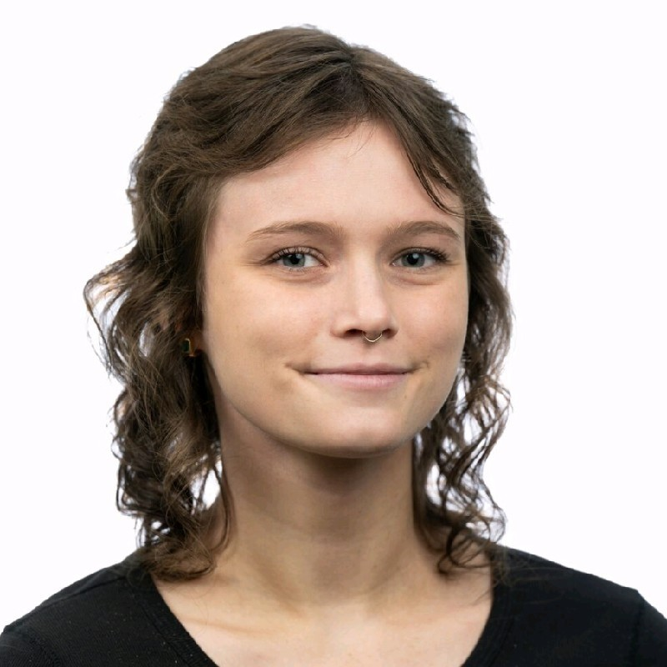


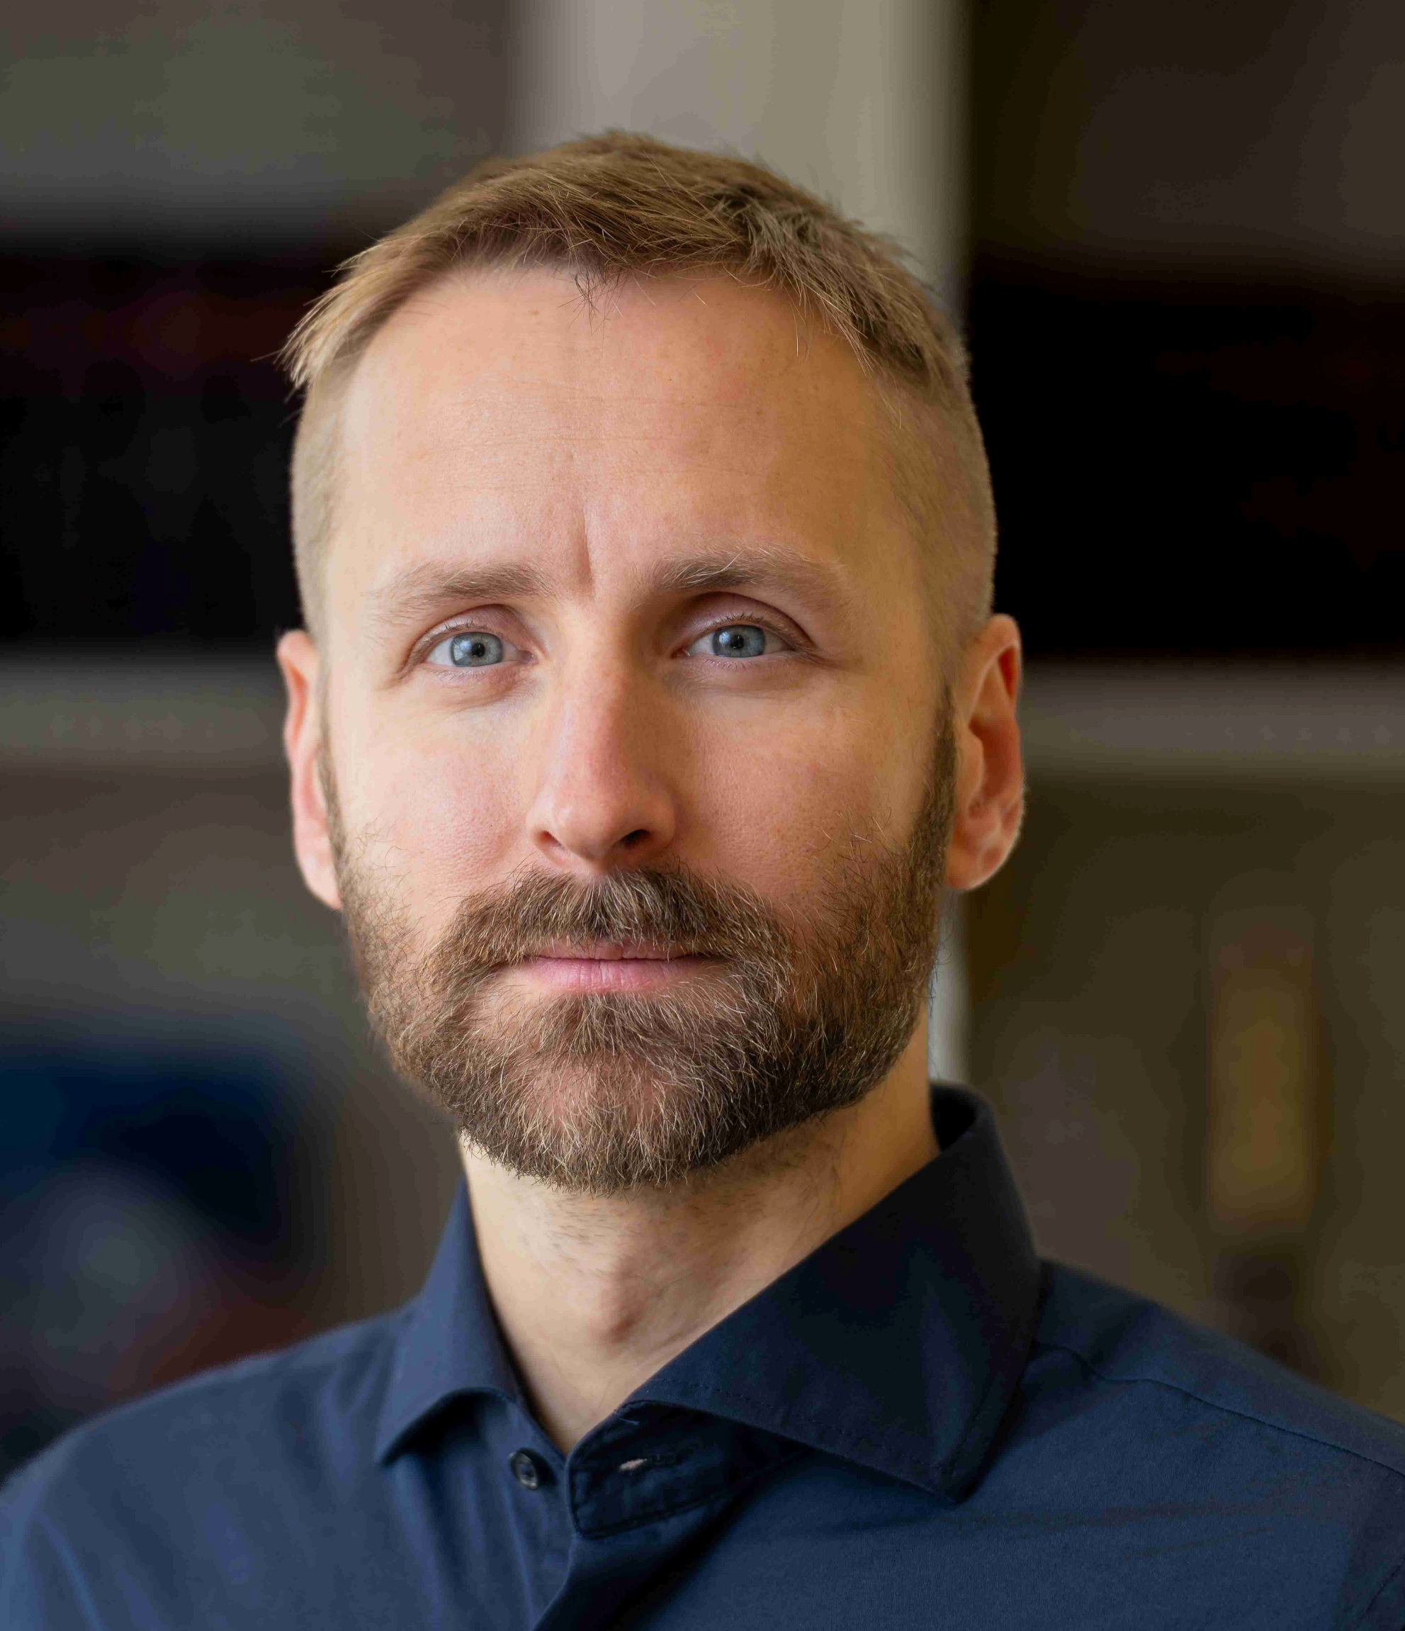

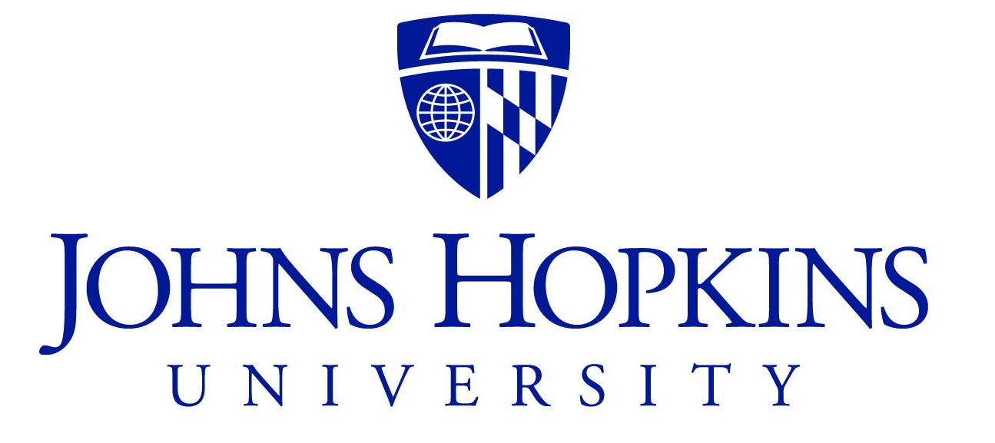

Co-Authors of Learning Neural Differential Algebraic Equations via Operator Splitting
James Koch
Madelyn Shapiro
Himanshu
Sharma
Draguna
Vrabie
Ján Drgoňa

Slide 12
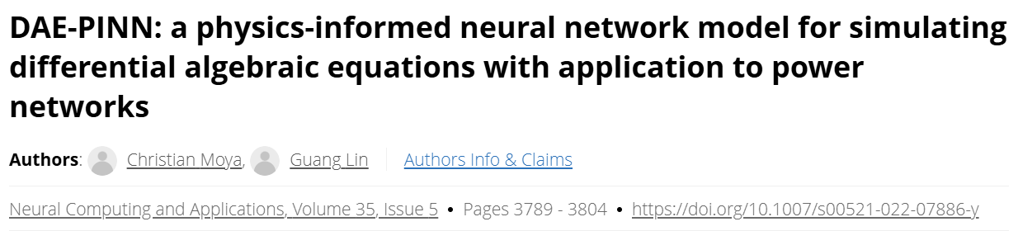
Prior and Recent Related Works

Slide 13

NeuroMANCER Scientific Machine Learning Library
Open-source library in PyTorch
Physics-informed Neural Networks
Learning to optimize
Neural differential equations
Learning to control
github.com/pnnl/neuromancer

Slide 14

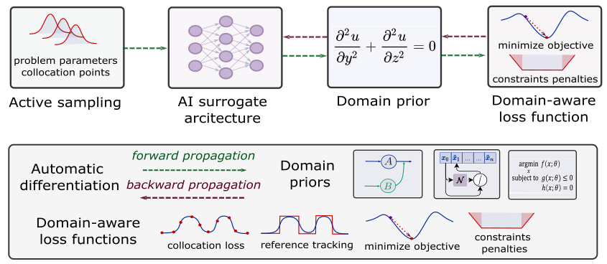
Summary
Scientific machine learning (SciML) methods integrating deep learning, constrained optimization, physics-based modeling, and control
Learning to solve (L2S)
Learning to optimize (L2O)
Learning to model (L2M)
Learning to control (L2C)
Challenges
High-index DAEs
Gradients ill conditioning for deep graphs
Computational cost of guarantees
Opportunities
Large-scale systems
PDE optimization and control
Development of new software tools
drgona.github.io/NeuralDAEs/
drgona.github.io/
jdrgona1@jh.edu

